Slide 1




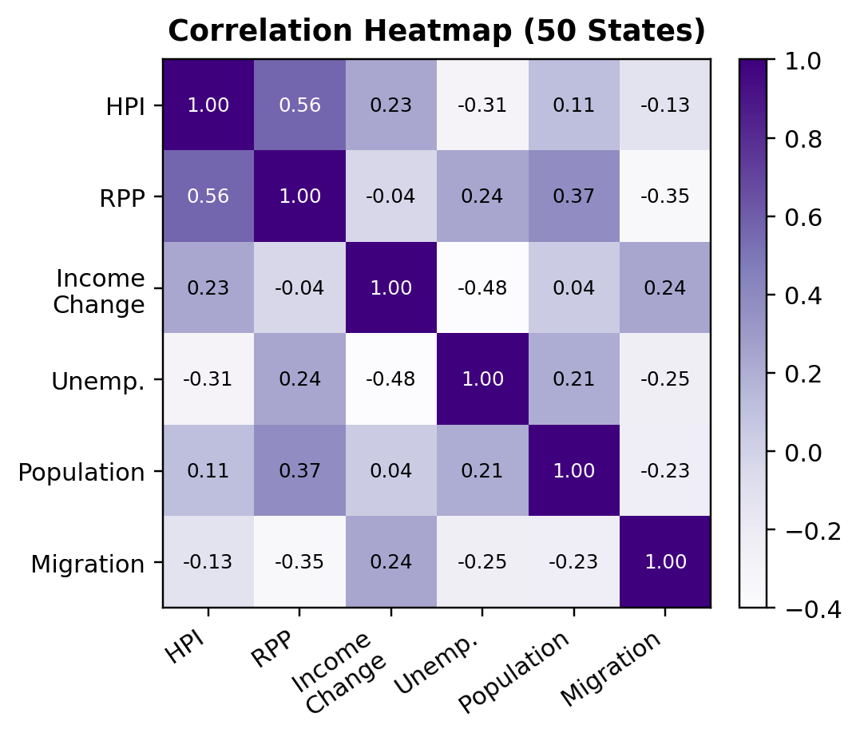
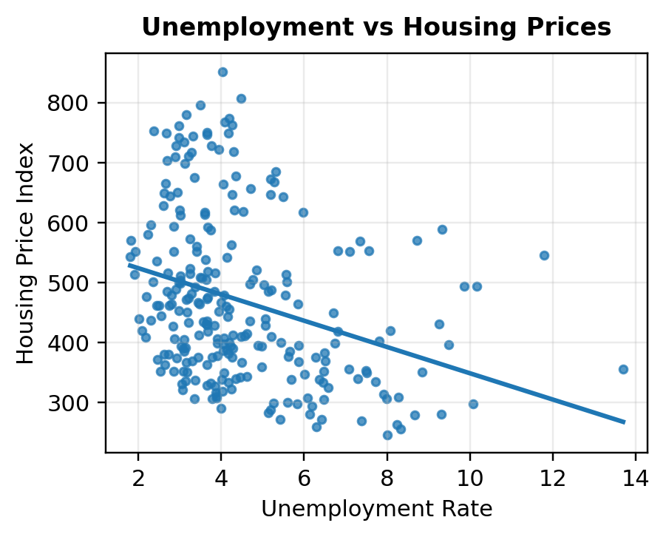
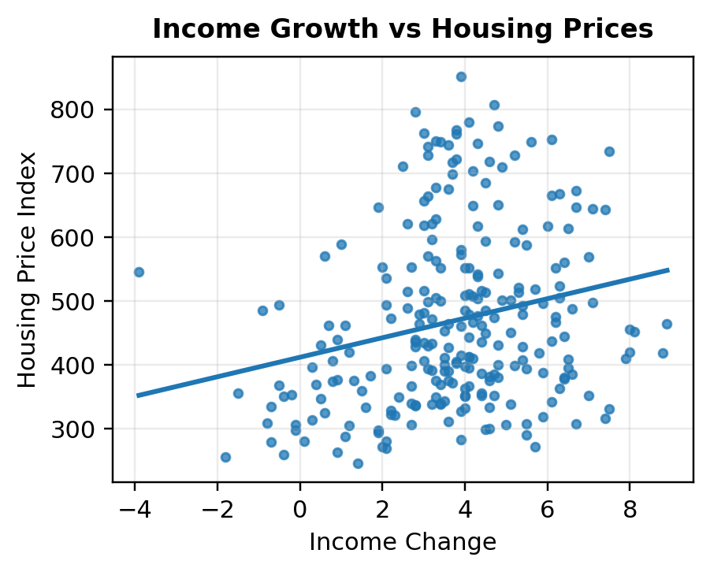
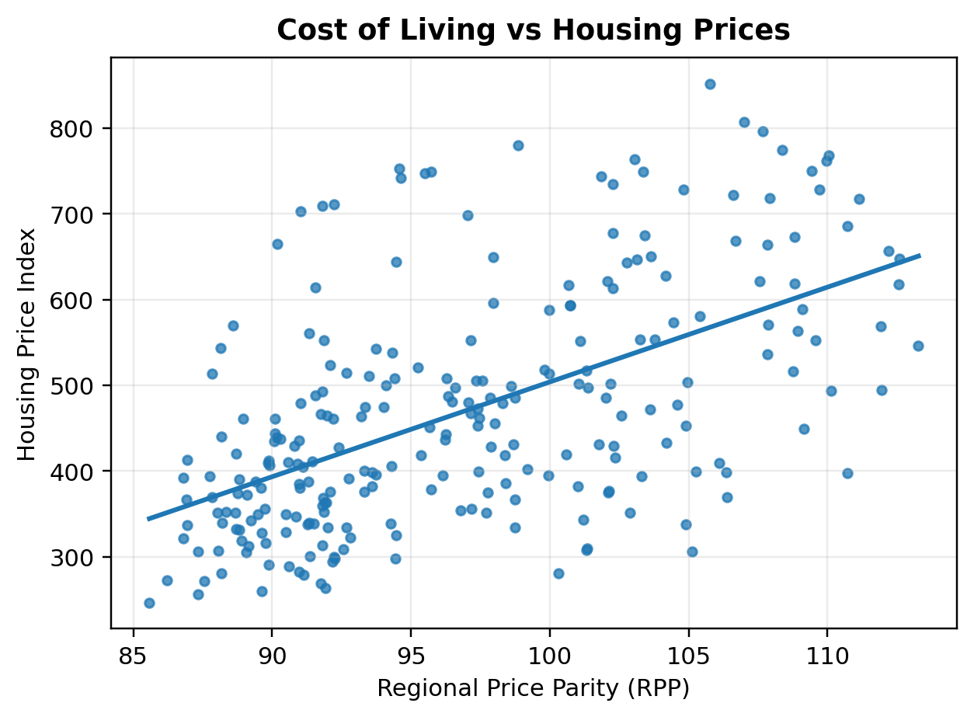
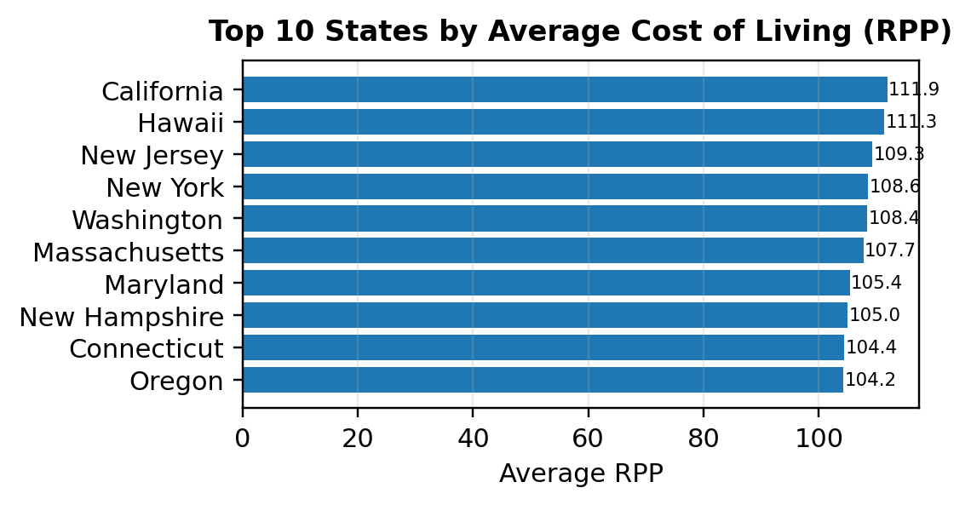
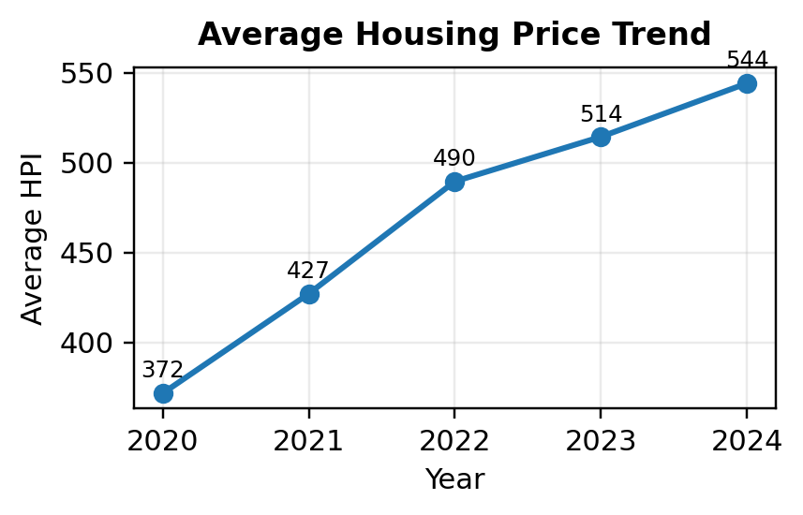
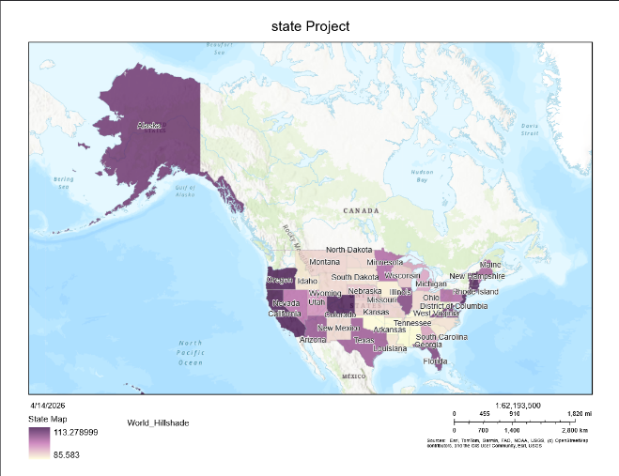
Economic Drivers of U.S. Housing Prices
Stanley Occean & Jonah Liautaud
CS 668 – Analytics Capstone
This project examines how unemployment, income growth, cost of living, population, and migration relate to housing prices across the 50 U.S. states.
Introduction
Correlation Heatmap
Unemployment/Income Growth
Results (Main Findings)
Higher unemployment aligns with lower HPI.
Housing prices rose steadily from 2020 to 2024.
RPP has the strongest link with HPI (about 0.56-0.60).
Income shows a positive but weaker relationship.
Unemployment is negatively associated with HPI.
Population is weak on its own.
Migration is the weakest factor and is limited to 2021-2023.
Random Forest outperformed linear regression in the full dataset, while linear regression performed better in the migration subset.
Housing prices vary significantly across U.S. states due to differences in economic conditions. Understanding these drivers is important for explaining affordability and regional disparities in the housing market.
Literature review - mobile phone price prediction
RPP shows the strongest relationship; migration is weakest.
Income is positive, but weaker than RPP.
Housing prices are influenced by supply, demand, and macroeconomic conditions
Cost of living and income are major drivers of housing demand
Labor market conditions and migration patterns affect regional housing prices
Cost of Living vs Housing Prices
Interpretation
Housing prices are best explained by multiple economic factors working together. Cost of living is the strongest driver, while income and labor conditions provide additional explanatory power.
Results are based on correlation and regression analysis using the 50-state panel dataset.
Migration is limited to the 2021-2023 IRS flow years.
Data collection
Top 10 States by Average RPP
Sources: FHFA, BEA, BLS, Census, IRS
Time Period: 2020–2024
Variables:
Housing Price Index (HPI)
Regional Price Parity (RPP)
Income Change
Unemployment Rate
Net Migration
Conclusion
Housing prices reflect multiple economic factors rather than one single variable.
Strongest signal: cost of living (RPP).
Next steps: add housing supply, interest rates, and fuller migration coverage.
Higher-RPP states tend to have higher housing prices.
Housing Price Trend
Spatial Analysis
References
Data & Method
[1] U.S. Census Bureau, “State Population Totals and Components of Change: 2020–2025,” 2026.
[2] U.S. Bureau of Labor Statistics, “Local Area Unemployment Statistics (LAUS),” 2025.
[3] Federal Housing Finance Agency, “FHFA House Price Index Datasets,” 2025.
[4] U.S. Bureau of Economic Analysis, “Regional Price Parities by State and Metro Area,” 2024.
[5] E. L. Glaeser, J. Gyourko, and R. E. Saks, “Why Have Housing Prices Gone Up?” American Economic Review, vol. 95, no. 2, pp. 329–333, May 2005..
2020-2024 state-year panel covering all 50 states
Sources: FHFA, BEA, BLS, Census, IRS
Methods: EDA, correlations, multiple linear regression, and Random Forest comparison
.
Model Concept:
HPI = f(RPP, Income, Unemployment, Population, Migration)
The average HPI rose from 372 in 2020 to 544 in 2024.
Choropleth map of housing price index across U.S. states. Darker shades indicate higher housing price levels, highlighting regional disparities with higher concentrations in coastal and economically strong states.

